Slide 1
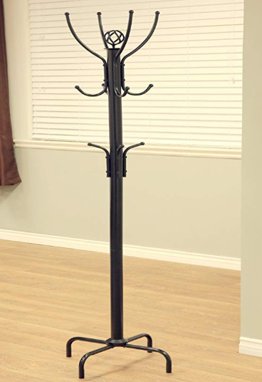
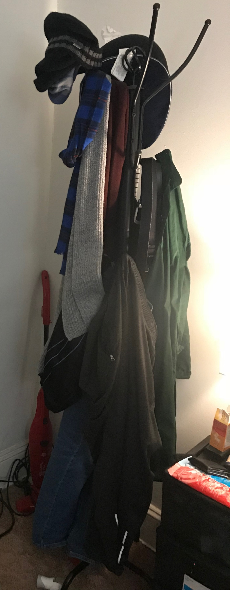
Coat rack
$10
In the room
product

Slide 2
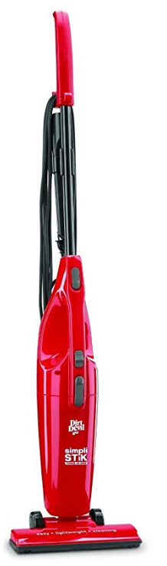
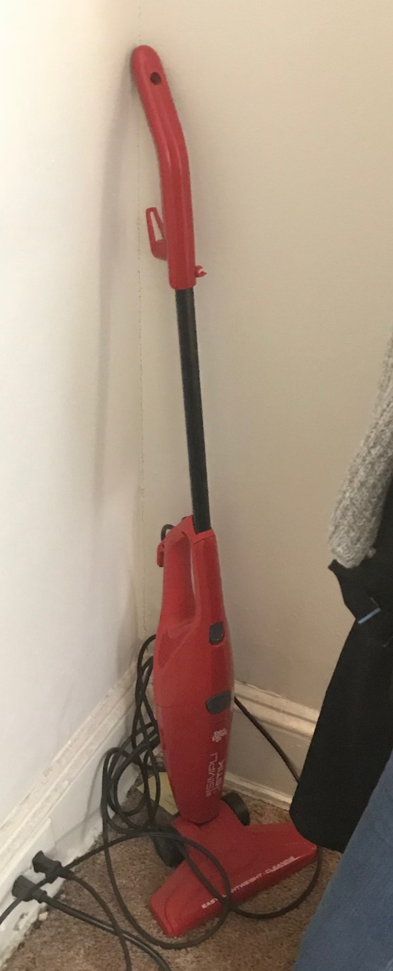
Lightweight bagless vacuum cleaner, good for carpets, detachable
$15
In the room
product

Slide 3
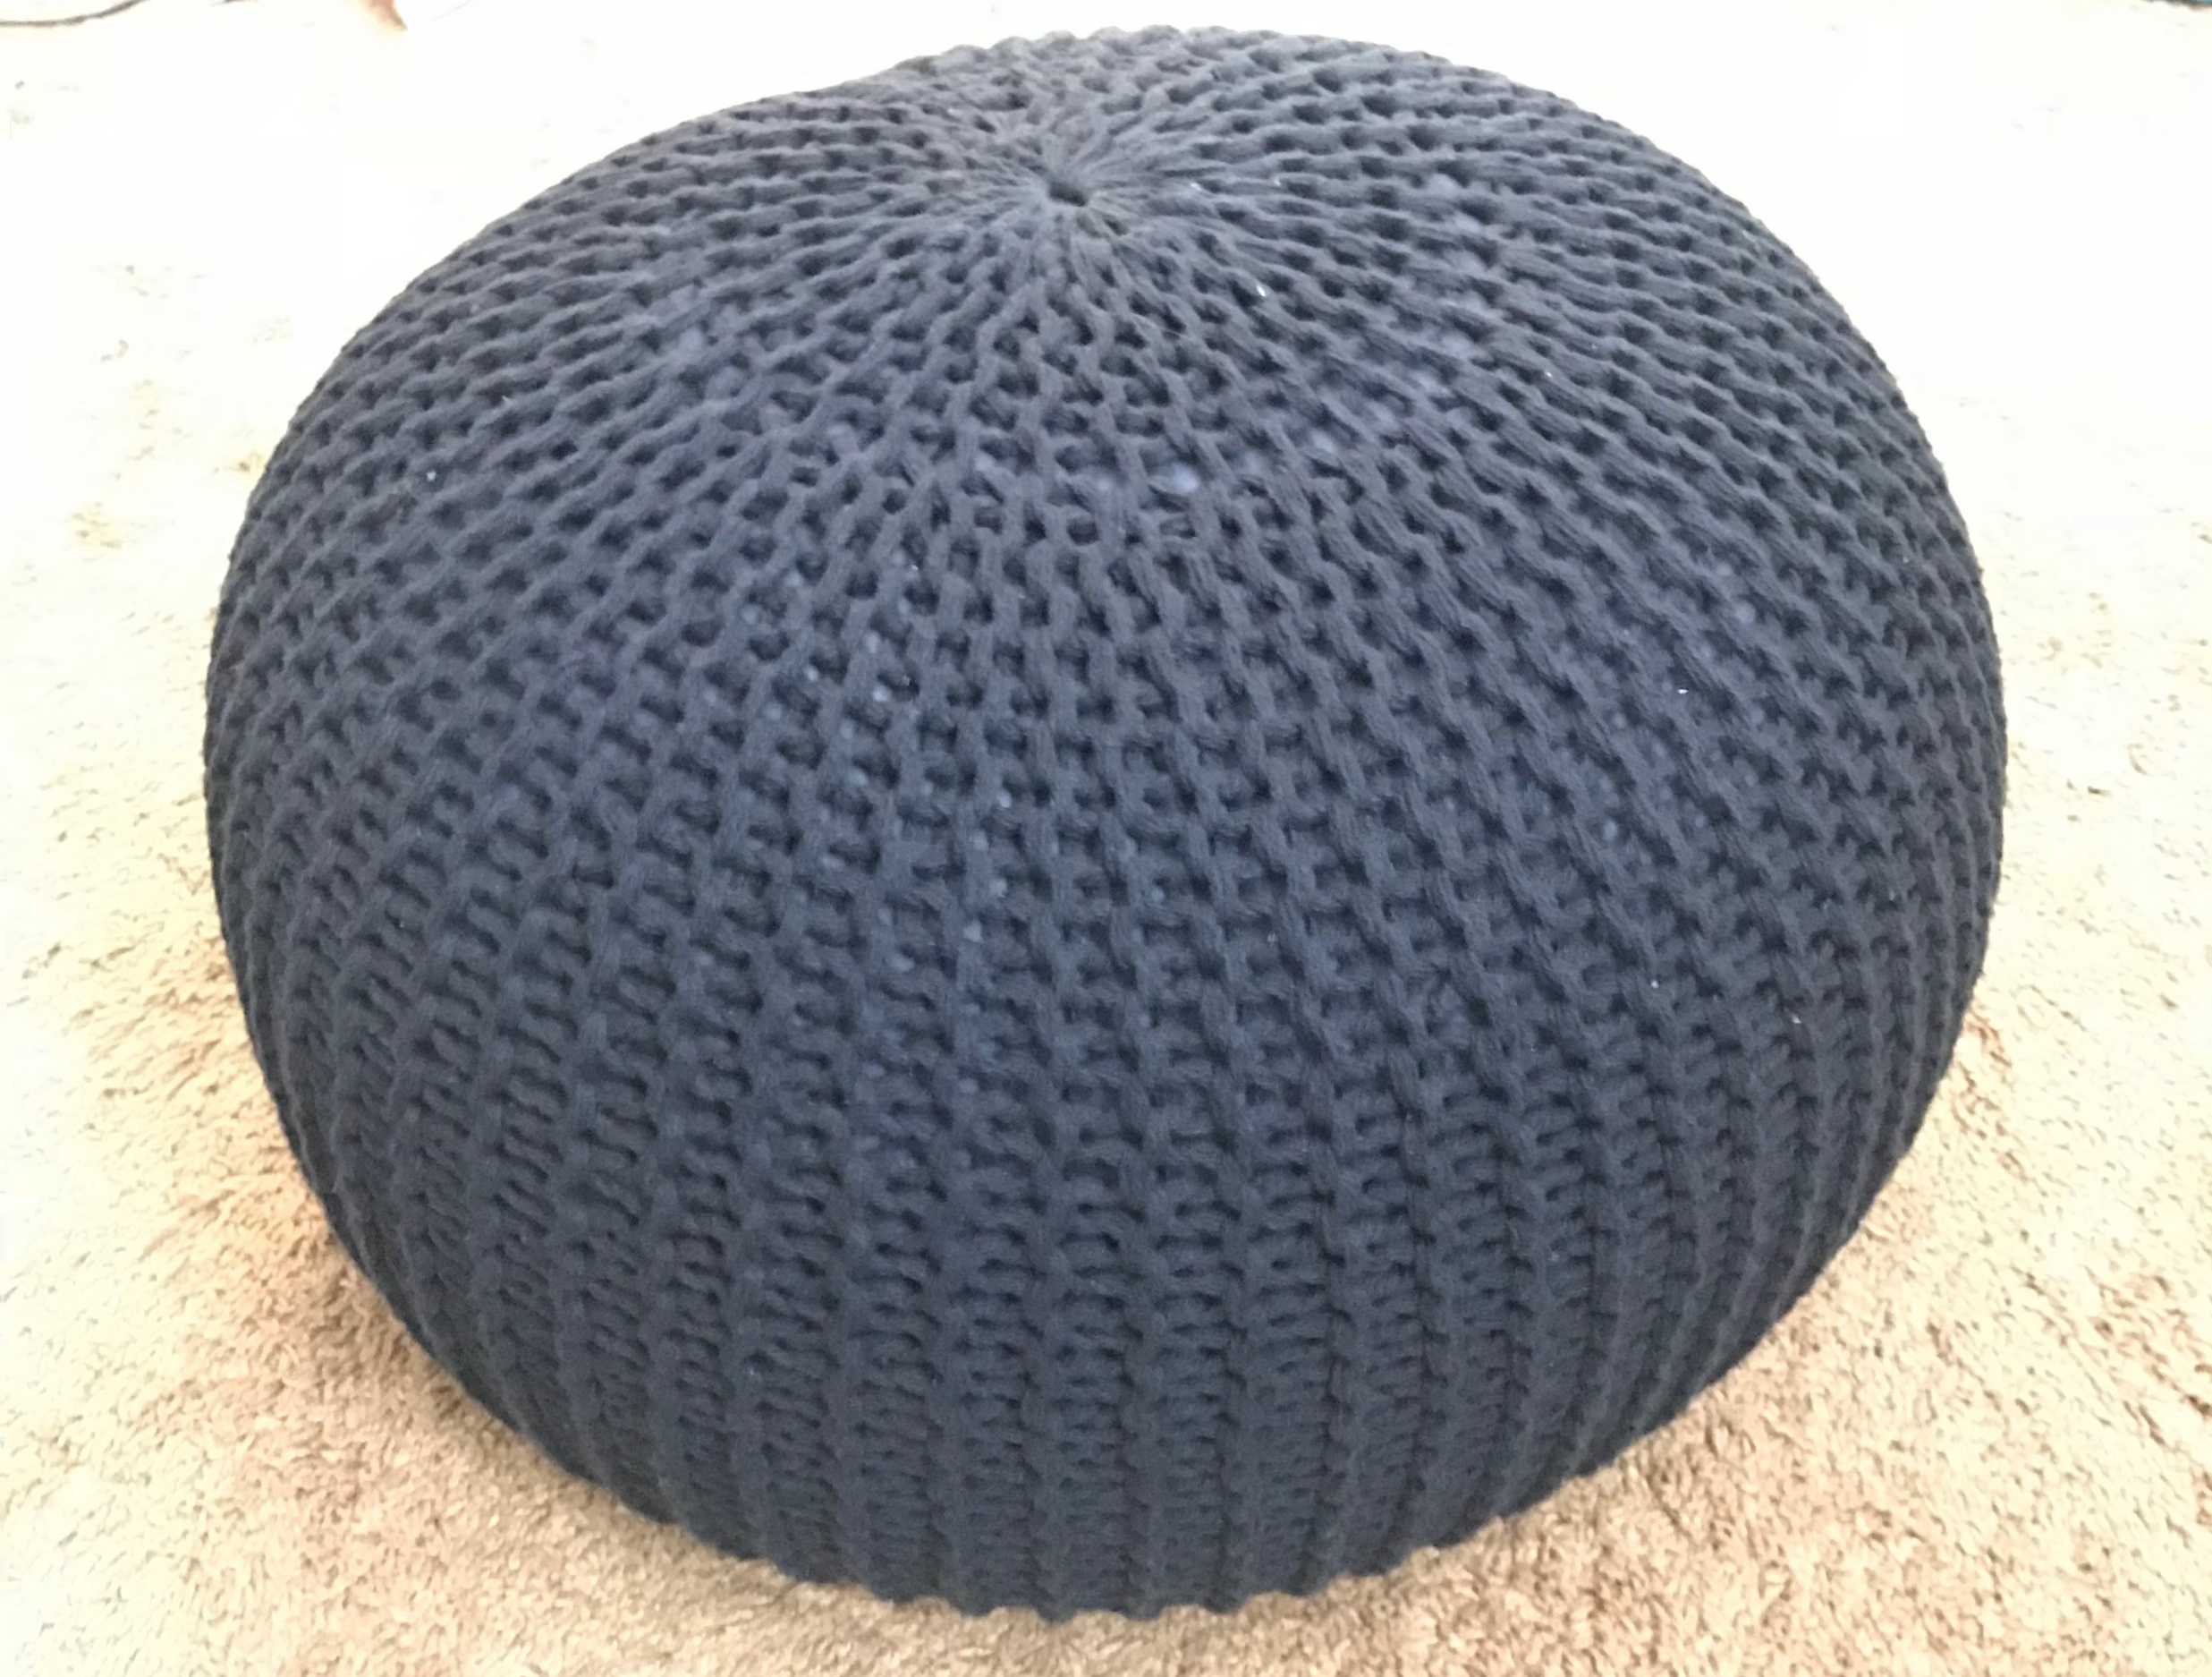
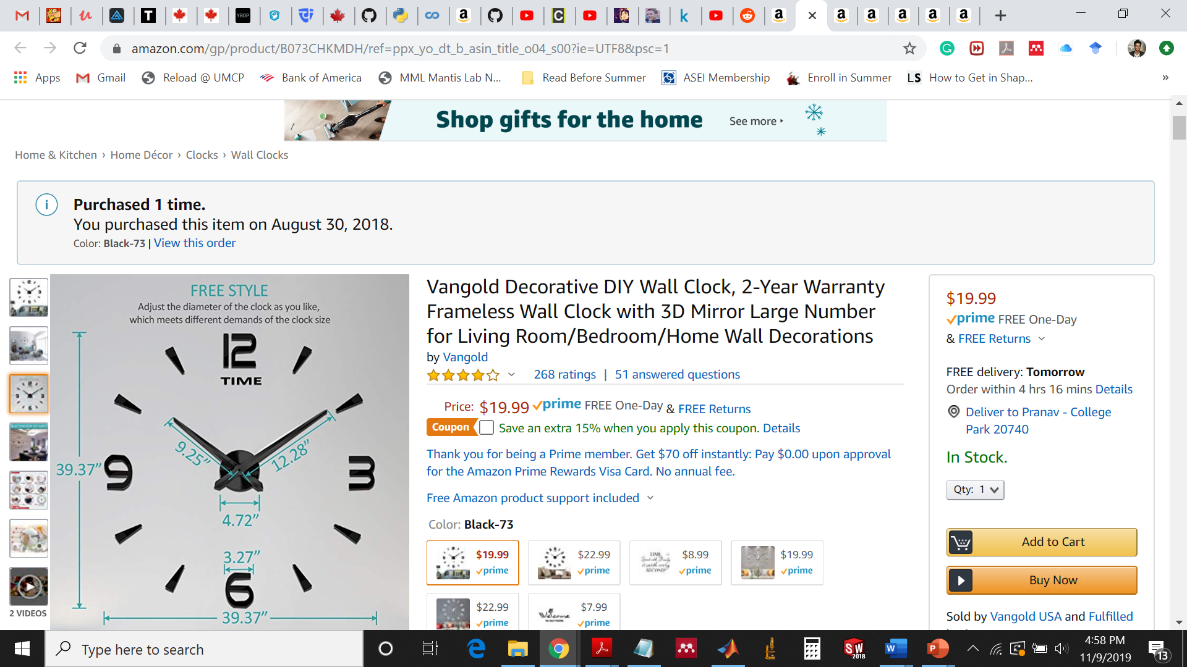
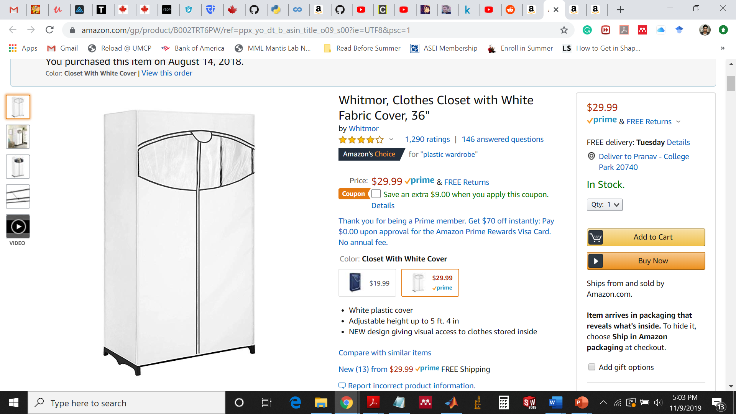
DIY wall clock
$10
Hand woven cotton pouf
$20
36” tall external wardrobe
$15

Slide 4
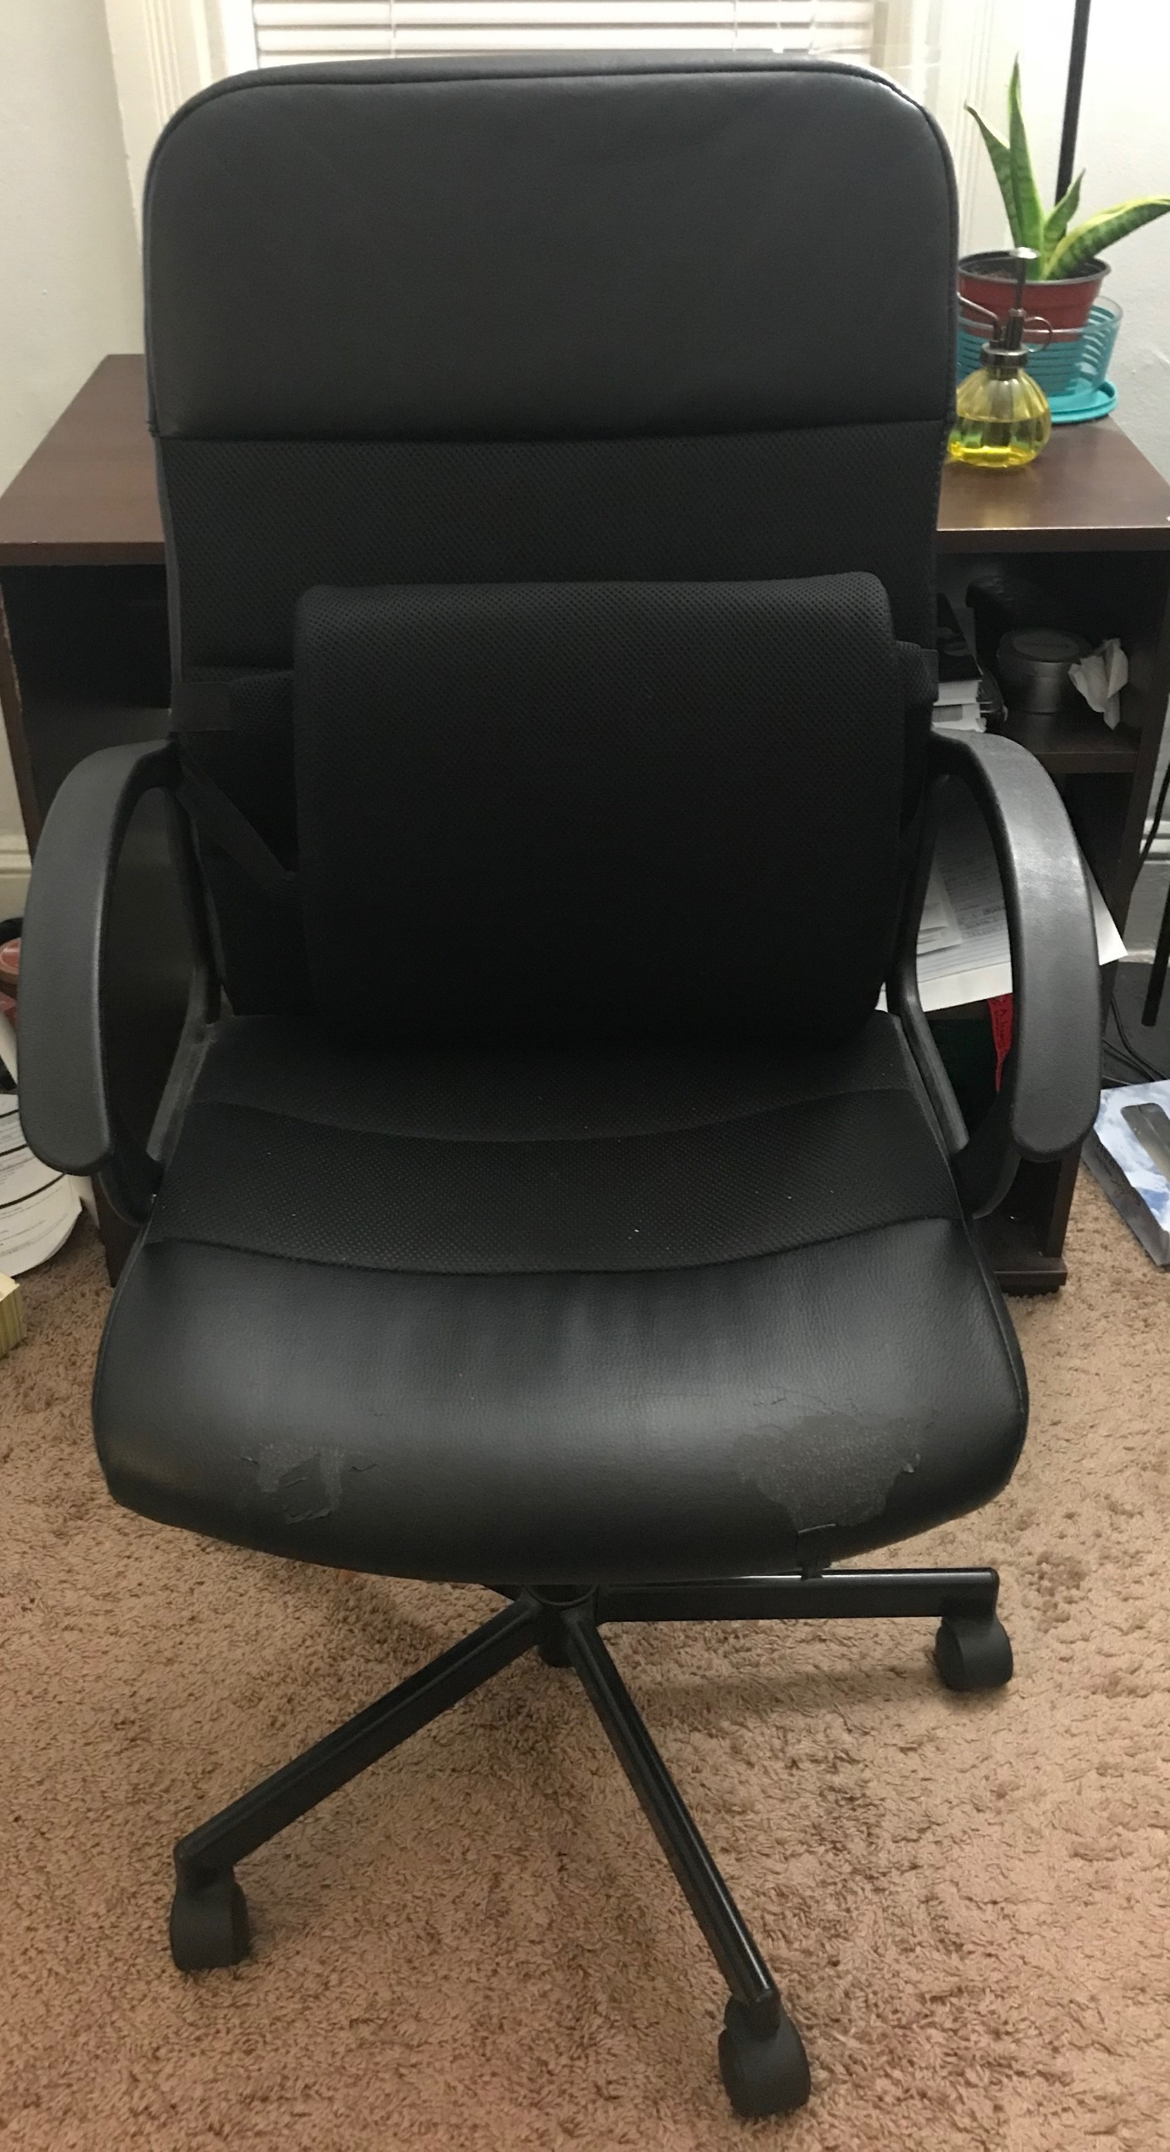
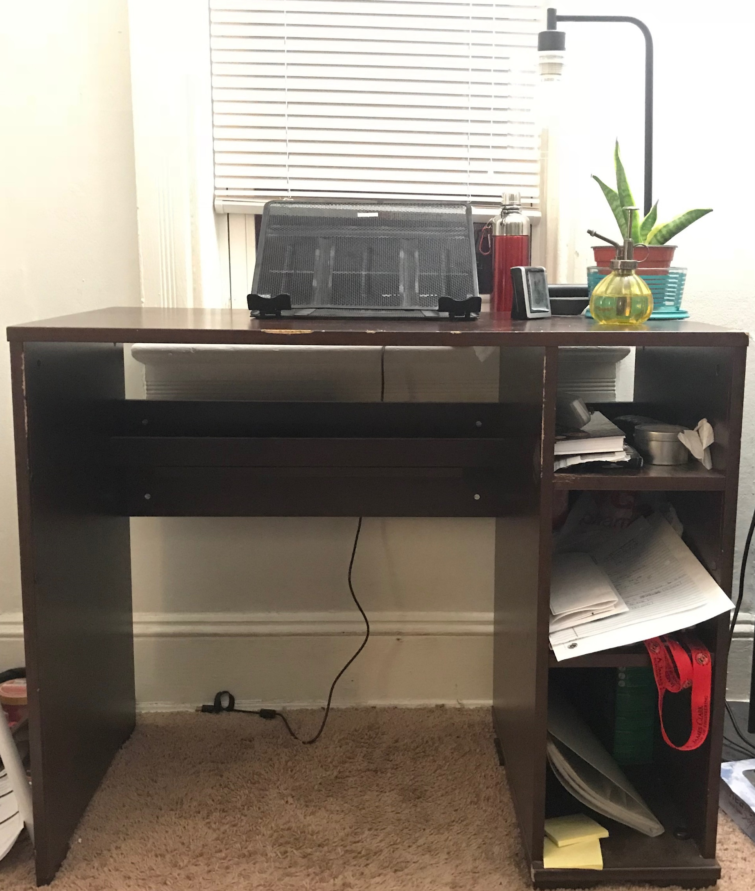
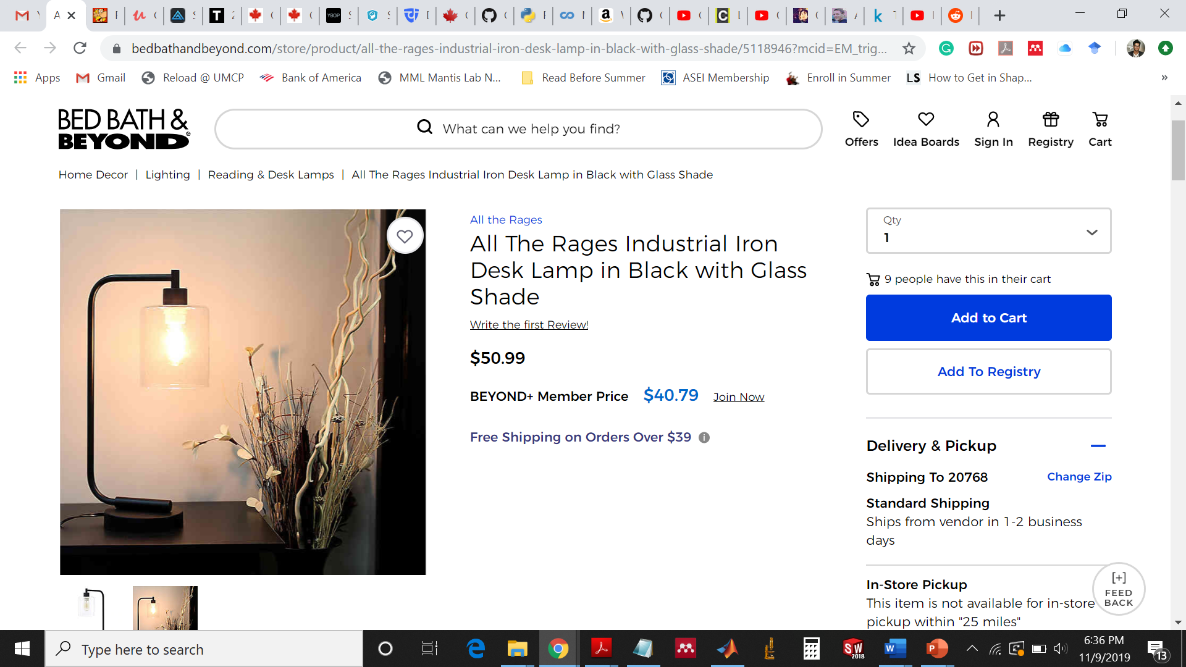
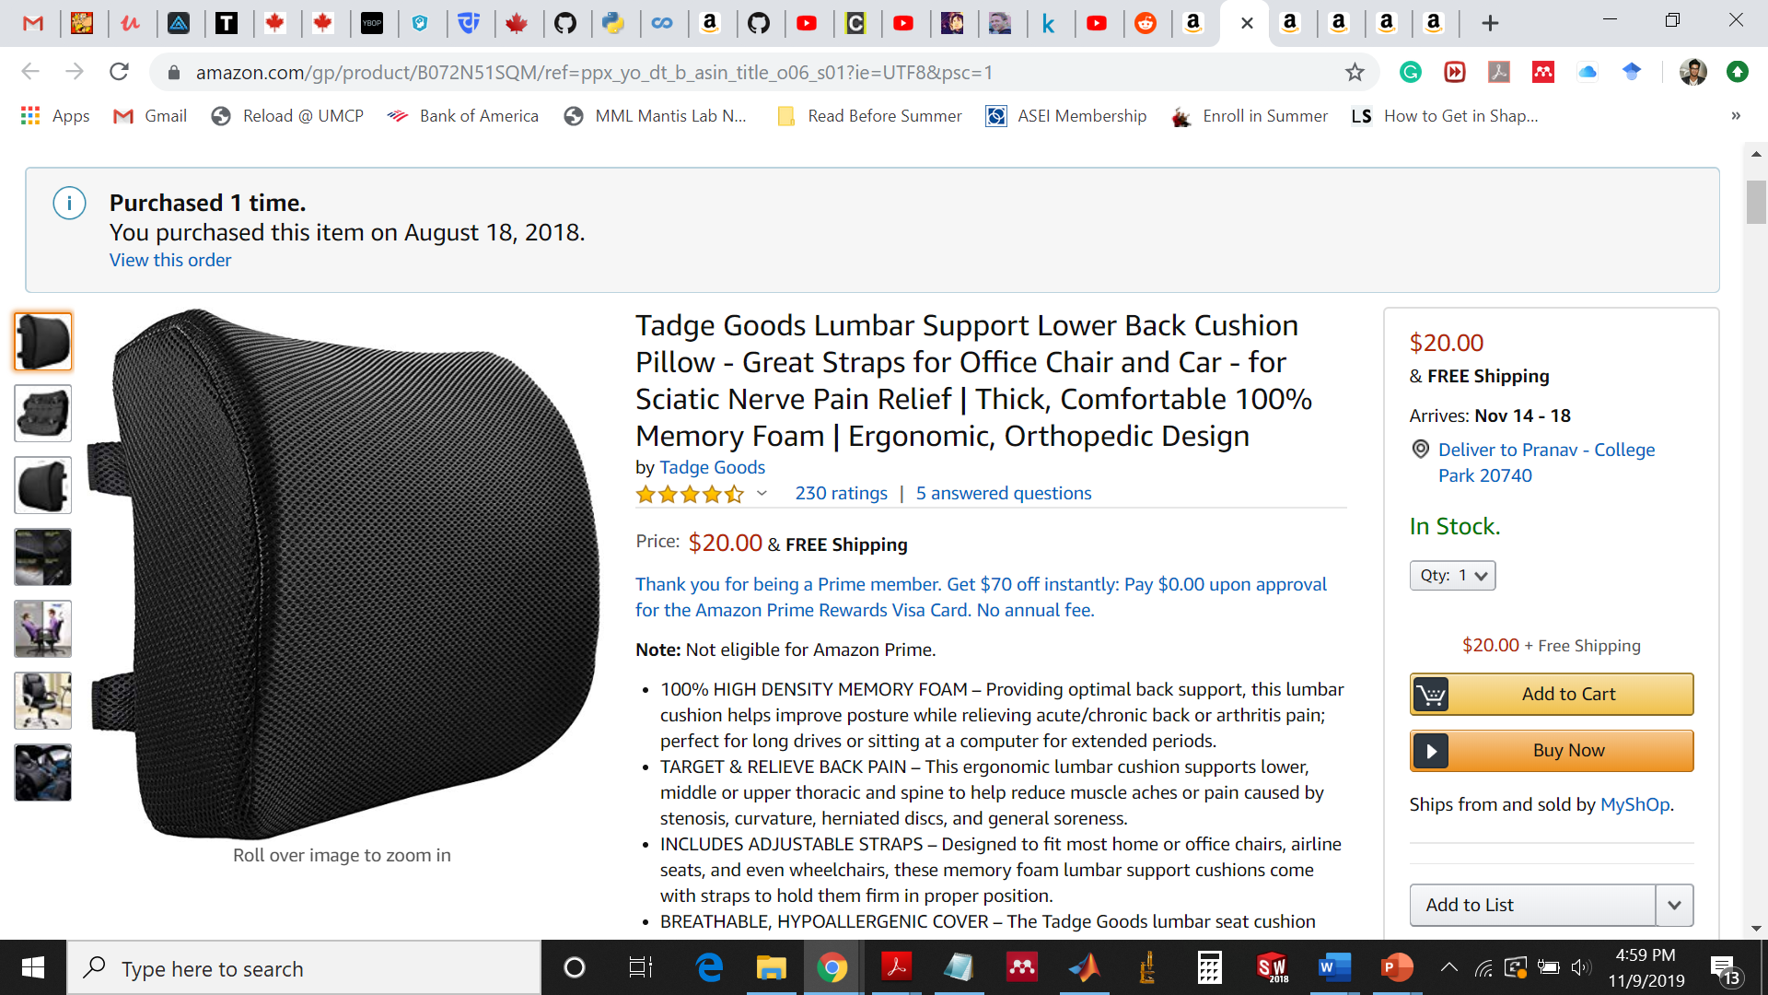
Lumbar support lower back cushion + chair + table = $20
Iron table lamp with bulb = $40 (Brand new)

Slide 5
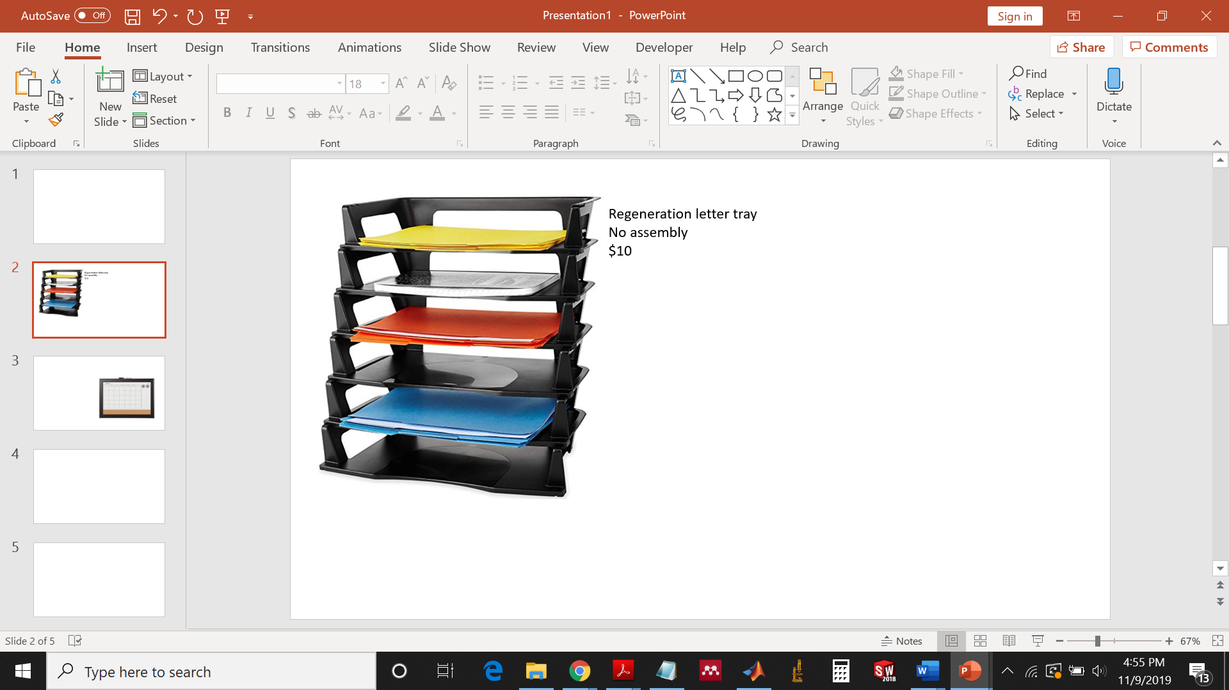
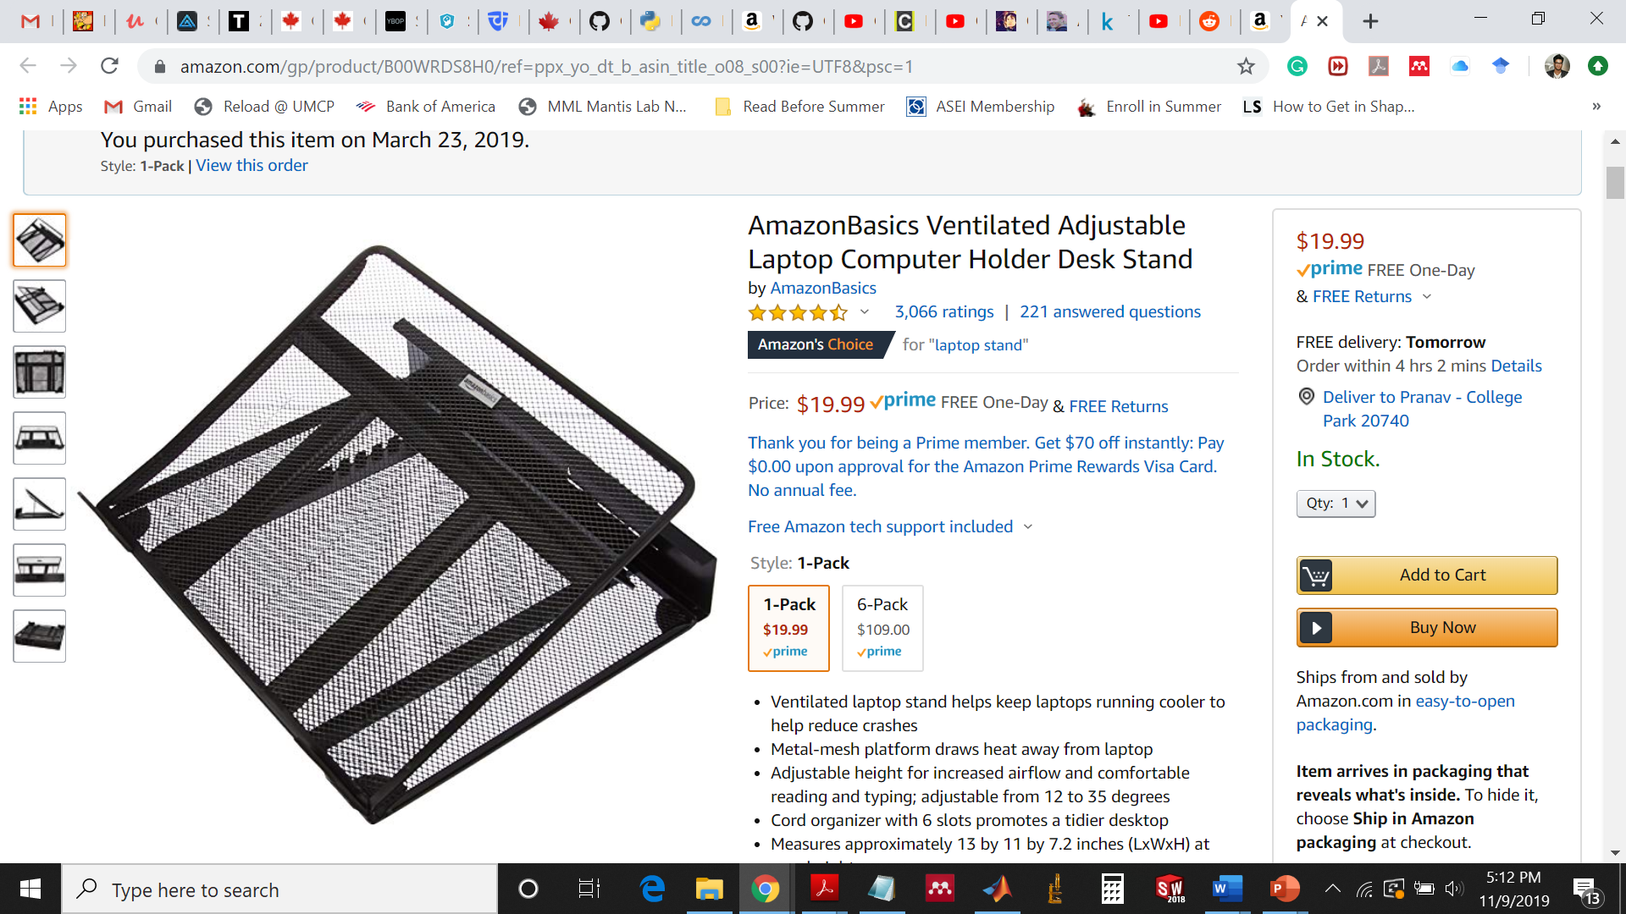
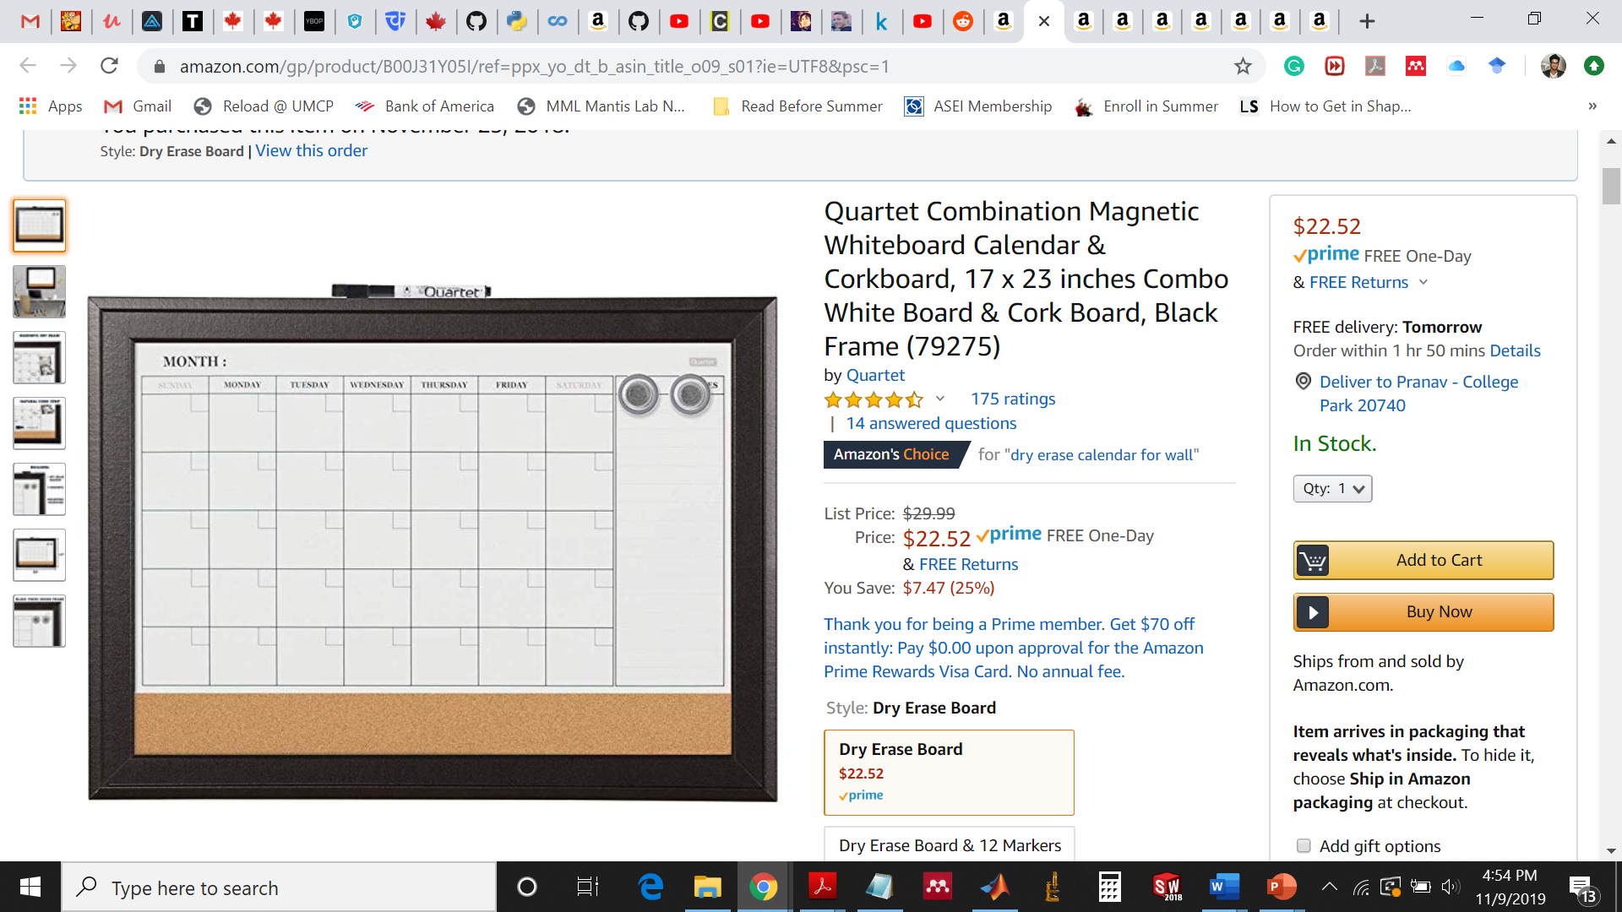
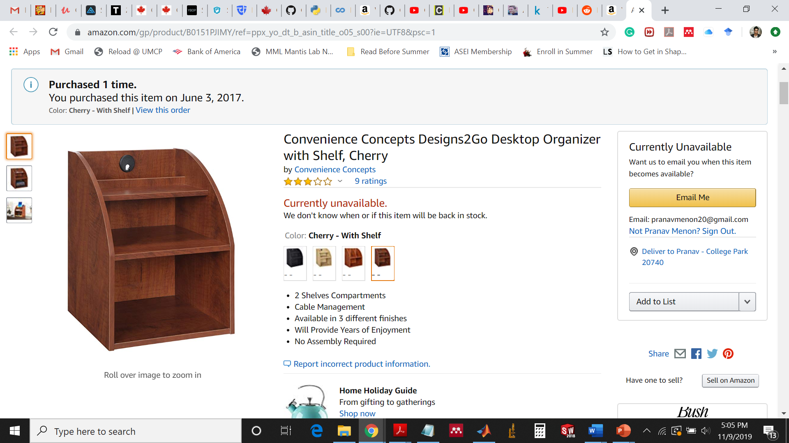
Ventilated adjustable laptop stand
$15
Desktop organizer with shelf
12.8” x 9.8” x 15.8”
$20
Dry erase 17x23” calendar whiteboard
$15

Slide 6
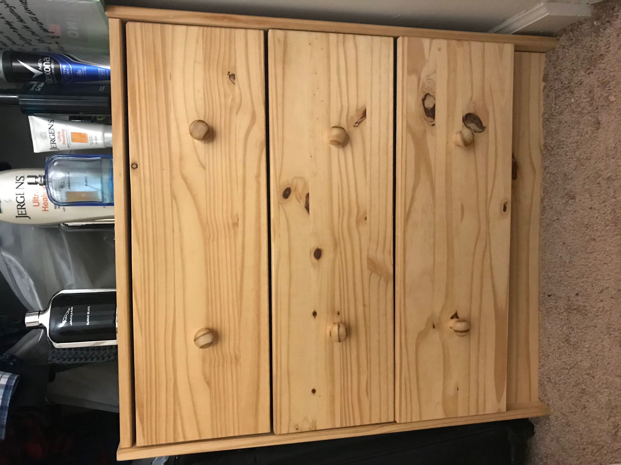
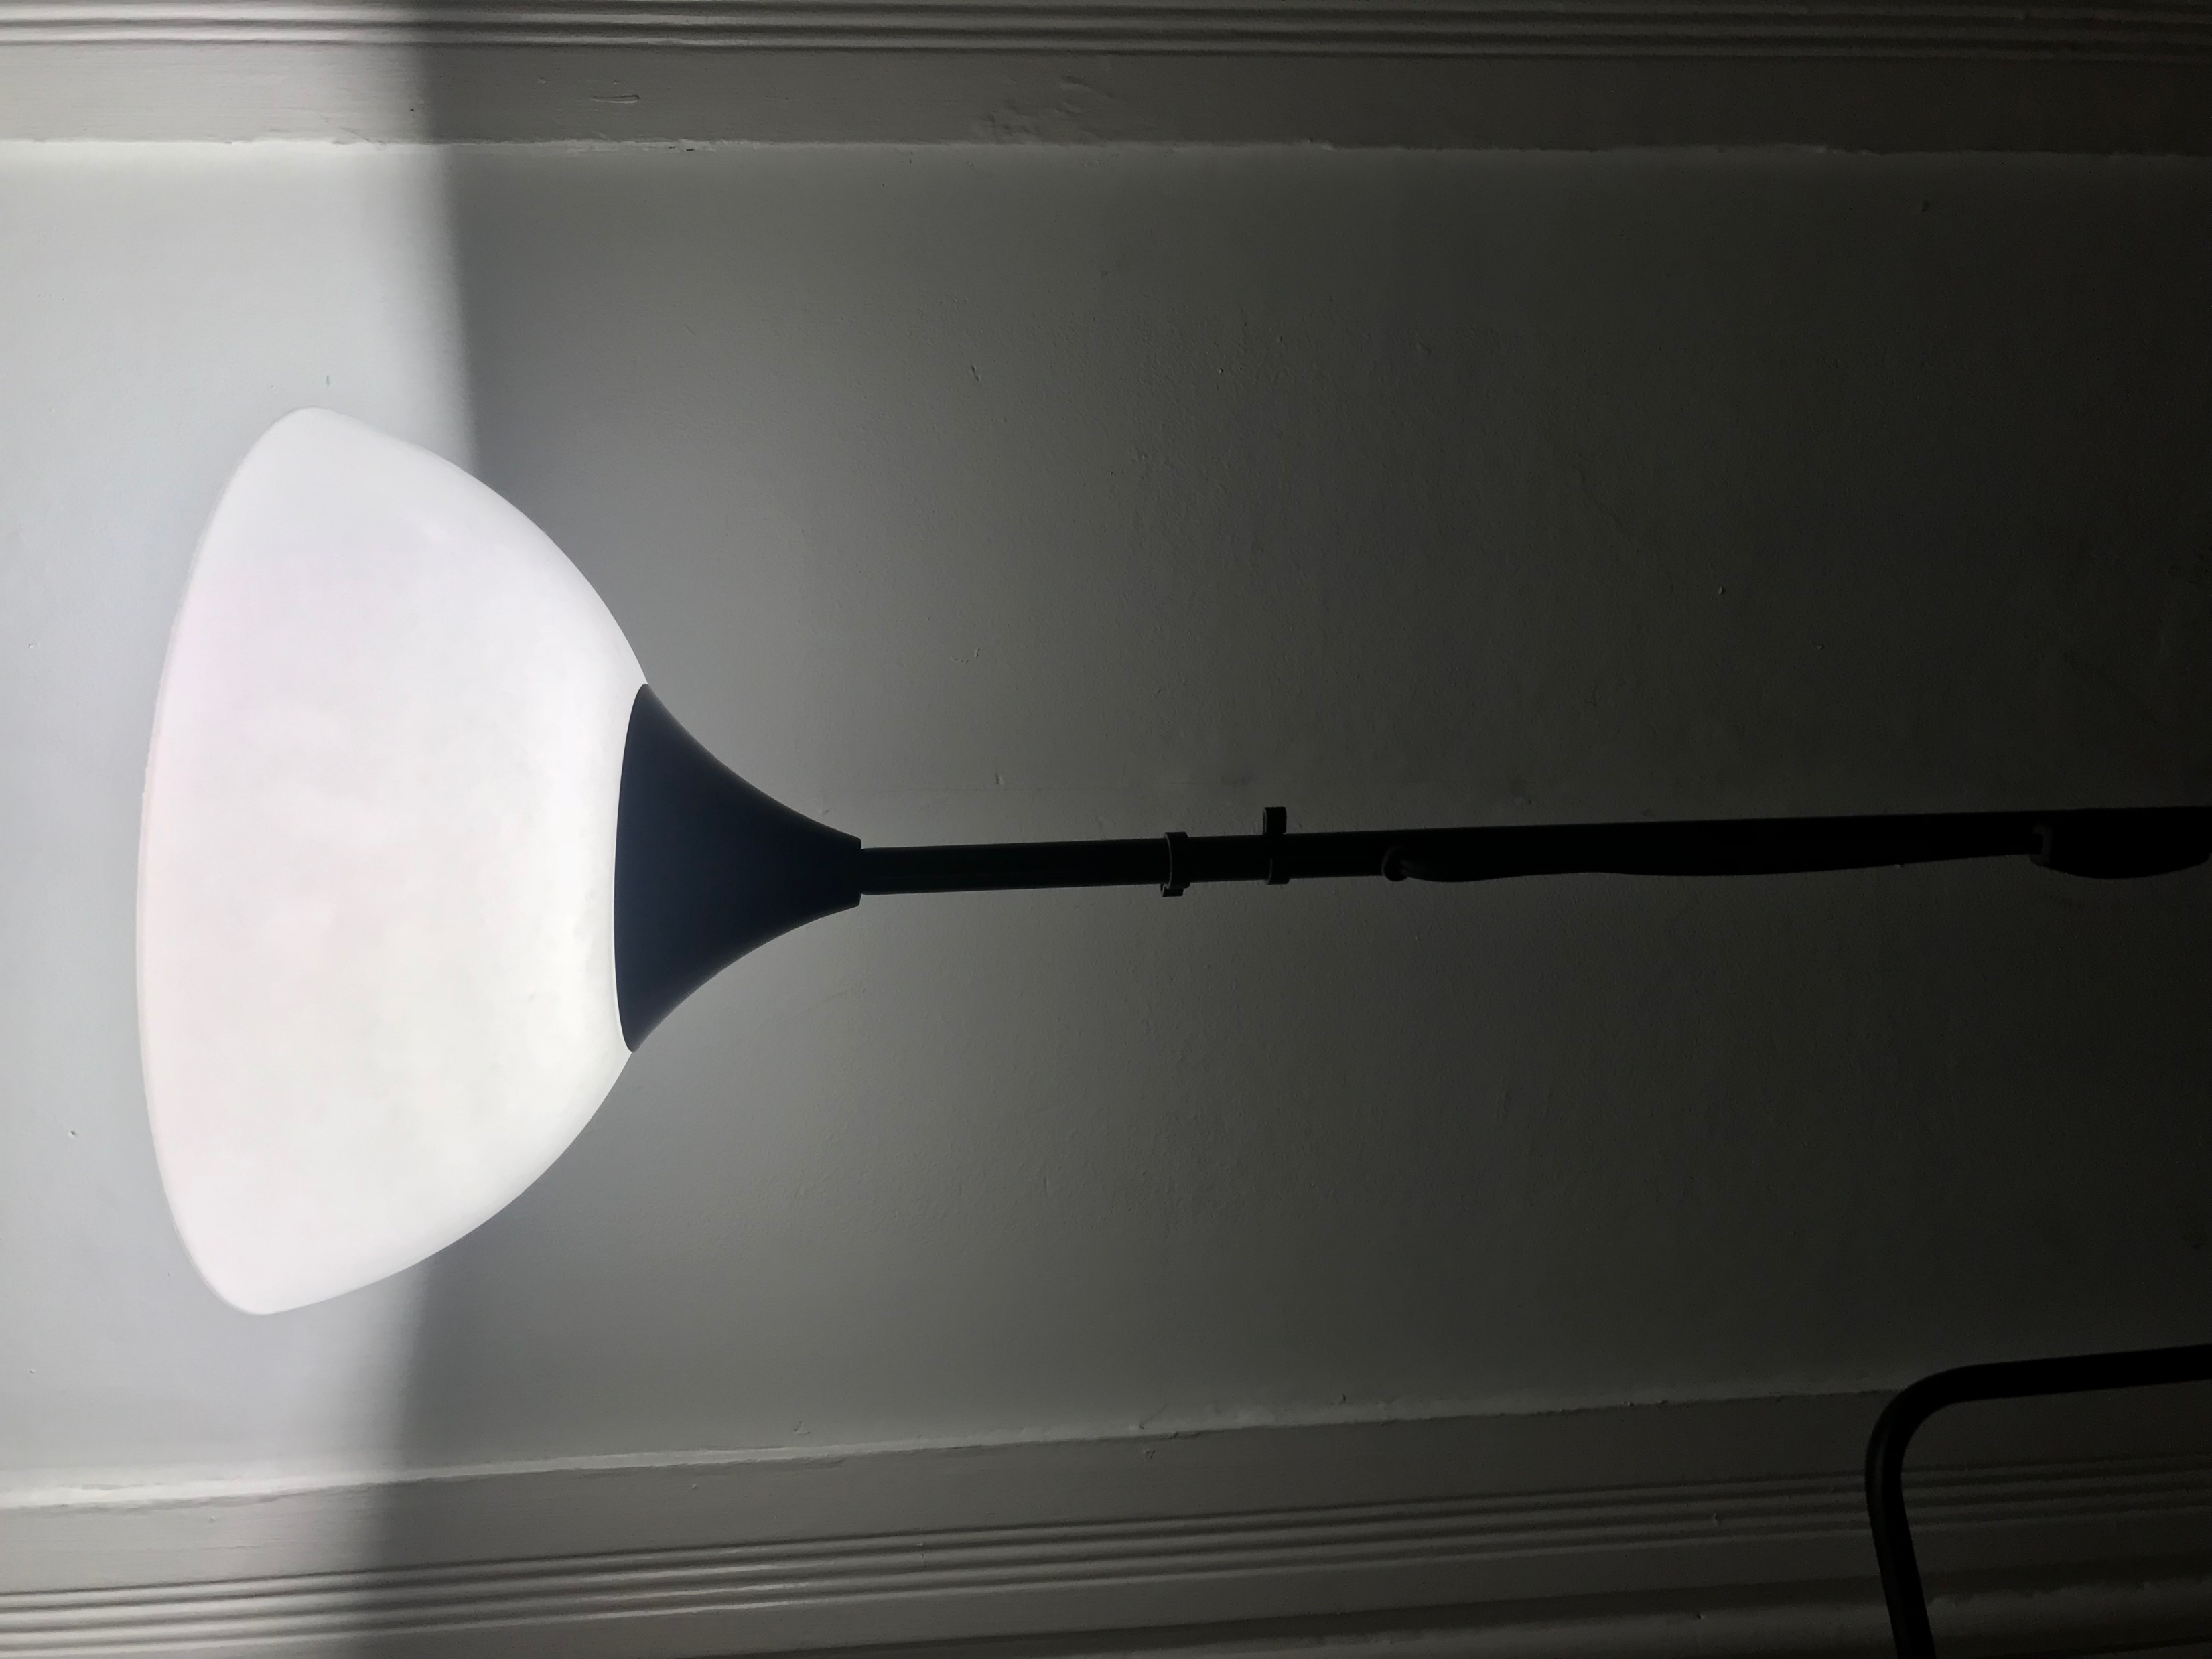
3 tier IKEA dresser: $30
Free

Slide 7
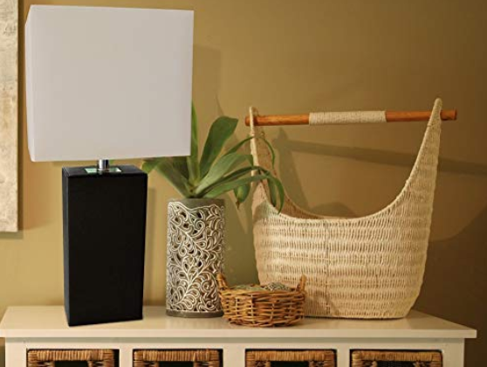
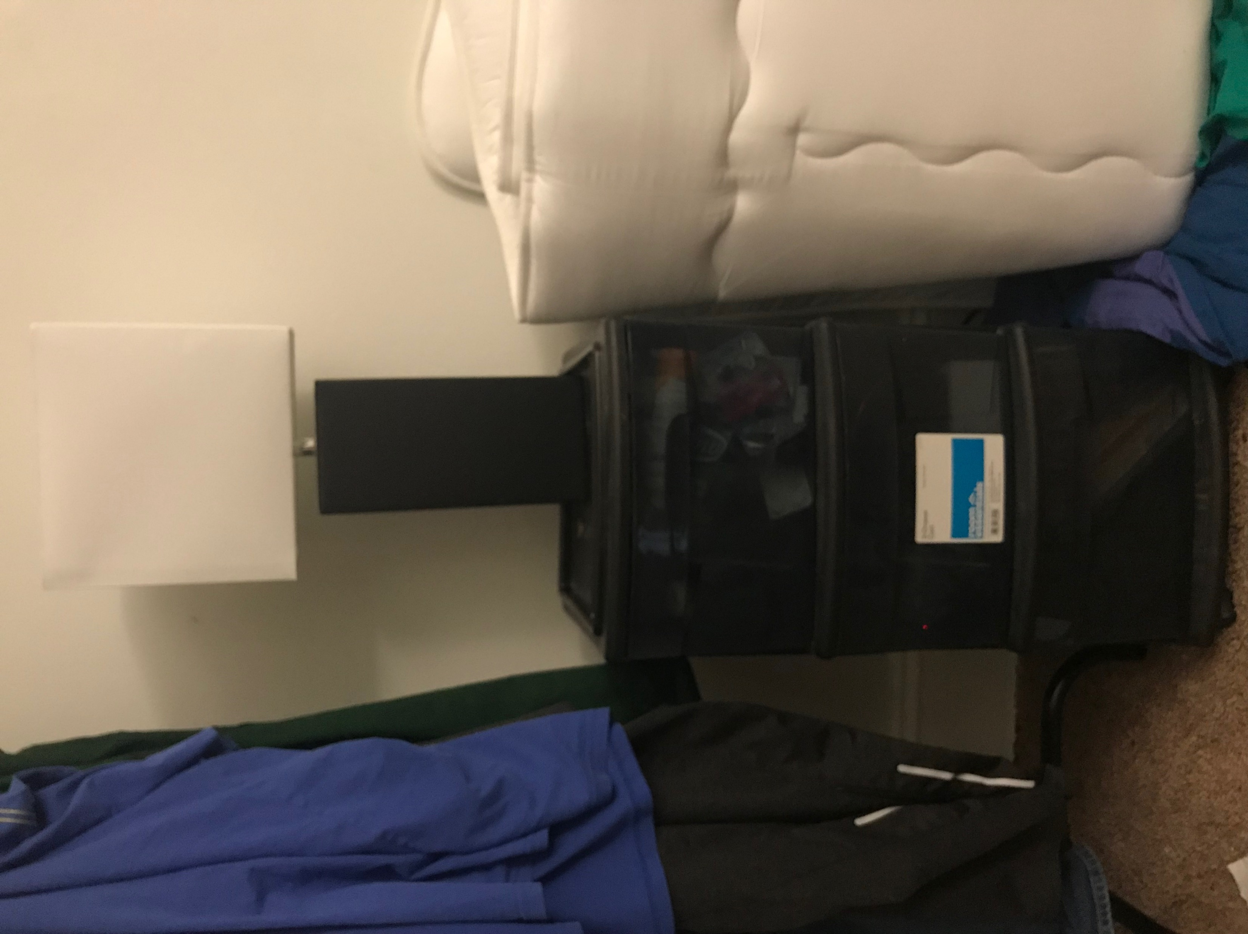
Night lamp leather body, white fabric shade with bulb
= $15
3-tier shelf = $5
product

Slide 8
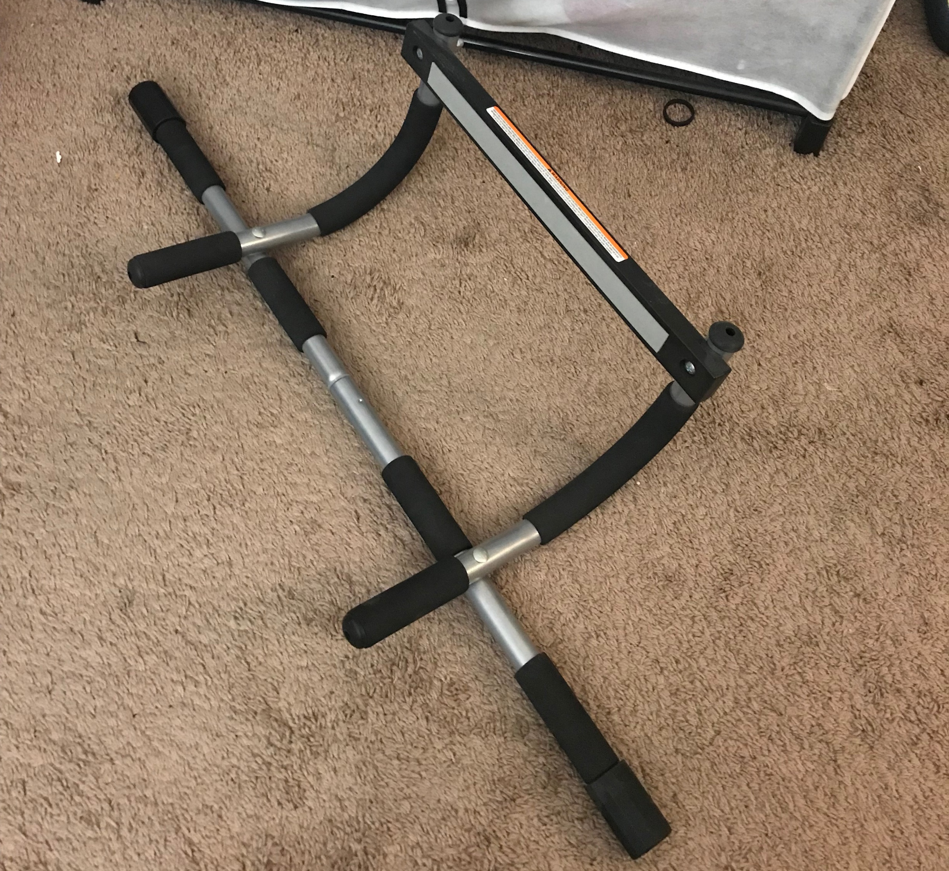
Sturdy upper body workout bar
$15

Slide 9
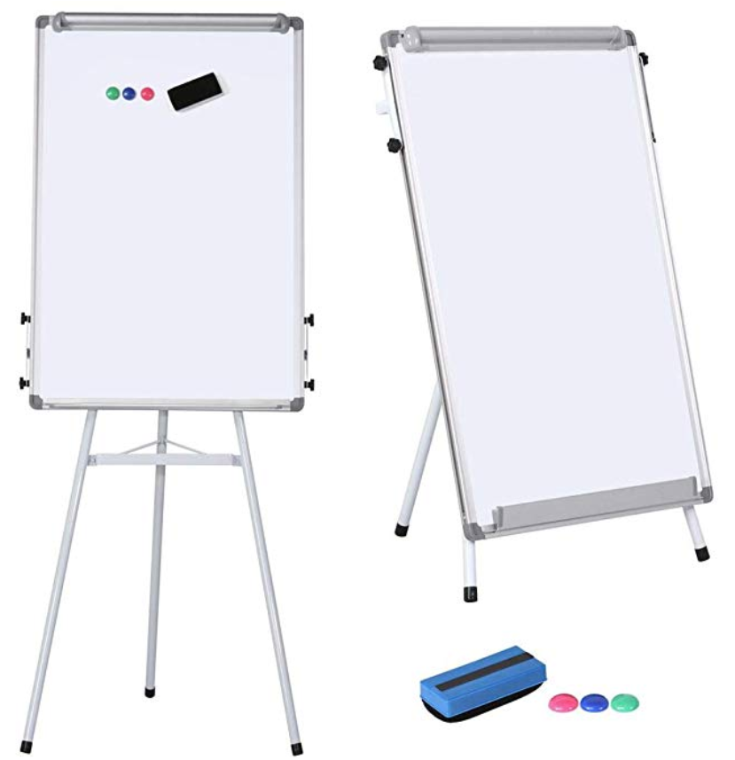
Magnetic dry erase 36x24” whiteboard, presentation board, adjustable tripod height
$50

